Slide 1


SAP S/4HANA Training
MASTER DATA GOVERNANCE (SAP MDG)
Neeraj Gupta
Session 07
SAP MDG – UI Modelling, standard objects, FPM

Slide 2
Floorplan manager application components
7
SAP MDG – UI Modelling

Slide 3
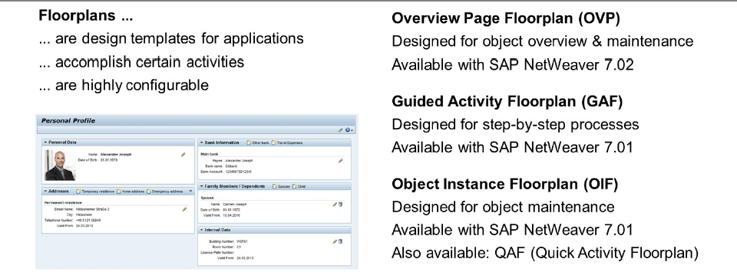
Types of Floor Plans
7
SAP MDG – UI Modelling

Slide 4
Material Domain - SPI Framework Integration
7
SAP MDG – UI Modelling

Slide 5
Business Partner / Finance Domain - BOL/ GENIL Layer Integration
7
SAP MDG – UI Modelling

Slide 6
Transaction: GENIL_MODEL_BROWSER
7
SAP MDG – UI Modelling

Slide 7
GENIL Root object BUPA for BP Model
7
SAP MDG – UI Modelling

Slide 8
GenIL root object MDGF for 0G master data model
7
SAP MDG – UI Modelling

Slide 9
7
SAP MDG - UI Modelling
UI Adaptation Options (Transaction SPERS_MAINT, R_FMDM_MODEL)
Customizing
Client specific (Future upgrade won’t affect changes)
Can be done at runtime / design time
Personalizing
User specific personalization
ONLY during runtime by end user through user settings
Enhancement
Cross client changes (Future upgrade won’t affect changes)
Design time changes
Context Specific Adaptions
Changes based on application data (Future upgrade won’t affect changes)
ONLY at runtime based on conditional logic & field values
Copy Application Configuration
Deep Copy, use enhancements (Future upgrade will affect changes)
Changes remains in Customer namespace
Modification
Leads to configuration changes to standard application. (Not recommended)
Changes will be overwritten on future upgrades

Slide 10
Create an adaptation for material type ROH. Click on Adaptations. Click on the Add button. Deselect Non-Specific for Material Type and enter ROH.
7
SAP MDG - Customizations, CBA
Action and mostly CR-Type are determined by URL, therefore these parameters can be used for adding/hiding UIBBs and adding/hiding fields in UIBBs. Material Type and Workflow Step are in standard not in the URL, therefore only adding/hiding fields in UIBB is possible.

Slide 11

End of Session 07

Slide 12

Questions

Slide 13

Neeraj gupta

Slide 14


We’re committed to empower you to be
Most Desirable Resource
through powerful training solutions.
We build the workforce of the future.
250+
Corporate Clients
30,000+
Learners Trained
25000+
Learners Placed
FREE WEBINARS
Sign up for free webinars with industry experts every fortnight!
Enroll Now!
Contact us today!
https://anubhavtrainings.com/

Slide 15




More from AnubhavTrainings.com

